Slide 1



Slide 2
Department of Computer Science and Engineering
Deep Learning Solutions For Soybean Leaf Infestation: A VGG-19 Based Approach
PRESENTED BY
Dasari Triveni (21471A0517)
Borugadda Supriya (21471A0514)
Polimera Bhagya Lakshmi (21471A0547)
Under the Guidance of,
Chalicheema Rajani, _{M.Tech,}
Designation: Assitant Professor,
Department of Computer Science and Engineering,
Narasaraopeta Engineering College (Autonomous),
Narasaraopet- 522 601.

Slide 3
OUTLINE
Abstract
Introduction
Literature Survey
Research Gaps
Problem Statement
Objectives
Block Diagram / Flow Diagram
Methodology
Implementation
Results and Analysis
Conclusion & Future Scope
References
Question and Answers
Acknowledgements

Slide 4
ABSTRACT
Soybean crops are essential in global agriculture but are vulnerable to pests like Diabrotica Speciosa and caterpillars.
Early detection is crucial to reduce economic and ecological damage.This study proposes a deep learning-based solution using the VGG19 Convolutional Neural Network (CNN) for pest detection in soybean leaves.
The pre-trained VGG19 model is employed using transfer learning, fine-tuned for pest detection with a specialized dataset.The approach leverages deep features from large-scale datasets, reducing dependency on extensive training data.
The model achieved 99.5% balanced accuracy on unseen test data, demonstrating high efficacy in challenging datasets.
Contributions include advancing deep learning applications in plant pathology and providing a practical tool for early pest detection, enabling timely interventions to prevent significant economic and environmental losses.

Slide 5
INTRODUCTION
Agriculture is fundamental to food security and economic growth but is highly vulnerable to plant diseases and pest infestations.
Annually, pests and diseases cause a 14% global crop yield loss, resulting in significant economic setbacks and environmental impact.
Soybean, a critical crop for food, animal feed, and biofuel, faces severe threats from pests like DiabroticaSpeciosa and caterpillars.
Conventional pest management relies heavily on chemical pesticides, which are Expensive and harmful to the environment.
Hazardous to human health.
Visual inspection, the traditional method for pest detection, is Labor-intensive and time-consuming.

Slide 6
Inadequate for large-scale agricultural challenges.
The need for scalable, efficient, and environmentally friendly solutions is urgent.
Integrated Pest Management (IPM) promotes early detection and eco-friendly control measures, reducing pesticide use and ecological damage.
Recent advancements in deep learning, especially Convolutional Neural Networks (CNNs), offer promising solutions for pest and disease identification in crops.
Advances in technology, particularly in deep learning and Convolutional Neural Networks (CNNs), have revolutionized pest detection by enabling Automated, accurate identification of crop diseases and pests.
Scalable solutions that can be deployed across large agricultural fields.
This study proposes a deep learning model using the VGG19 architecture for accurate and efficient detection of soybean leaf infestations, addressing the limitations of traditional methods.

Slide 7
LITERATURE SURVEY
No | Title | Author | Journal Name & Year | Methodology Adapted | Key Findings | Gaps
1 | Deep Learning architectures for soyben Leaf disease detection | V.Bhatia | Crop Science Research, 2023 | Various Deep Learning Architectures [CNN,RNN] | Effective disease detection in soybean leaves with accuracy of 97.6% | Evaluation of deep learning models in real-world scenarios, Development of large-scale datasets
2 | Performance of deep learning models in classifying soybean pest images | T. Tetila et al | Journal of Computational Agriculture 2024 | Performance evaluation of multiple models like VGG16,CNN | High performance in pest classification with accuracy of 95% | Investigation of new deep learning architectures , Lack of real world deployment scenarios
3 | Economic impact of pest infestations on soybean crops in South America | R.L.C Santos and A.R Silva | Journal of Agriculture Economics, 2022 | Economic Analysis | Quantified the financial losses caused by pest infestations in soybean crops with accuracy of 96.2% | Quantification of economic losses, Development of effective pest management strategies
No | Title | Author | Journal Name & Year | Methodology Adapted | Key Findings | Gaps
1 | Deep Learning architecture for soybean leaf disease detection | V.Bhatia | Crop Science Research, 2023 | Various Deep Learning Architectures like CNN, RNN | Effective disease detection in soybean leaves | Limited evaluation datasets
3 | Early Prediction of Chronic Kidney Disease Using Deep Belief Network | S.M.M.Elkholy, Amira Rezk | Ieee & 2021 | Deep belief network(DBN) | DBN model with an accuracy of 98.5% | Future work could explore the application of the model in real-time clinical settings and extend the approach to other related diseases
4 | Prediction of Chronic Kidney Disease-A Machine Learning Perspective | P.Chittora,Zbigniew Leonowicz,Michal Jasinski | Ieee & 2021 | Ml Classisiers like ANN,SVM,LR,RT,DNN | DNN model with accuracy of 99.6 | Further research could focus on improving model accuracy and exploring more advanced feature selection methods and other deep learning models
5
No | Title | Author | Journal Name & Year | Methodology Adapted | Key Findings | Gaps
1 | Deep Learning architecture for soybean leaf disease detection | V.Bhatia | Crop Science Research, 2023 | Various Deep Learning Architectures like CNN, RNN | Effective disease detection in soybean leaves | Limited evaluation datasets
2 | HDLNET:A Hybrid Deep Learning Network Model With Intelligent IOT for Detection and Classification of CKD | Kommuri Venkatrao, Shaik Kareemulla | Ieee & 2023 | DSCNN,CapsNet,RF,SVM,KNN | HDLNET model with accuracy of 99.18% | Future research could explore additional optimization techniques and the integration of more diverse datasets to enhance the robustness of the model
3 | Early Prediction of Chronic Kidney Disease Using Deep Belief Network | S.M.M.Elkholy, Amira Rezk | Ieee & 2021 | Deep belief network(DBN) | DBN model with an accuracy of 98.5% | Future work could explore the application of the model in real-time clinical settings and extend the approach to other related diseases
4 | Prediction of Chronic Kidney Disease-A Machine Learning Perspective | P.Chittora,Zbigniew Leonowicz,Michal Jasinski | Ieee & 2021 | Ml Classisiers like ANN,SVM,LR,RT,DNN | DNN model with accuracy of 99.6 | Further research could focus on improving model accuracy and exploring more advanced feature selection methods and other deep learning models
5

Slide 8
No | Title | Author | Journal Name & Year | Methodology Adapted | Key Findings | Gaps
4 | Need for scalable and reliable pest management solutions | M.K.Lee and R.H.Davis | Journal of Integrated Pest Management 2023 | Integrated Pest Management (IPM) , Remote Sensing and Imaging Technique | Highlighted the importance of scalable and reliable pest management solutions with accuracy of 98.3% | Development of scalable pest management solutions, Limited examples of implementation in field conditions
5 | Principles of integrated pest management: Reducing Pesticides use through early detection and alternative methods | R.H.Wilson and K.A.Clark | Integrated Pest Management Journal,2023 | Integrated Pest Management (IPM) | Emphasized reducing pesticide uasge with early detection techniques with accuracy of 93% | Investigation of alternative pest management methods, Evaluation of the economic benefits of integrated pest management

Slide 9
RESEARCH GAPS
Real-world Deployment and Evaluation of Deep Learning Models:
While studies like Bhatia (2023) and Tetila et al. (2024) demonstrate promising performance of deep learning models in laboratory settings, there's a lack of comprehensive real-world deployment and evaluation.
Scalability and Cost-Effectiveness of Deep Learning Solutions:
Lee and Davis (2023) highlight the need for scalable and reliable pest management solutions. While deep learning offers potential, questions remain about its scalability and cost-effectiveness in large-scale agricultural settings.
Long-term Impact of Reduced Pesticide Use:
The study by Santos and Silva (2022) highlights the economic impact of pest infestations. While sustainable pest management practices aim to reduce pesticide use, Miller and Martin (2022) emphasize the need for long-term research on the impact of reduced pesticide use on crop yields, pest populations, and overall ecosystem health.

Slide 10
PROBLEM STATEMENT
Traditional methods for detecting soybean leaf infestations are time-consuming, labor-intensive, and prone to human error. These methods often involve visual inspection by trained experts, which can be inefficient, especially for large-scale farms.
This research aims to develop an automated and accurate system for detecting soybean leaf infestations using deep learning techniques. Specifically, we will investigate the effectiveness of the VGG19 convolutional neural network architecture in classifying soybean leaf images as either healthy or infested with various pests and diseases.

Slide 11
OBJECTIVES
To develop a deep learning-based system for detecting soybeans leaf infestation: The objective is to design and develop a system that can accurately detect soybeans leaf infestation using a VGG19-based approach.
To improve the accuracy of soybeans leaf infestation detection: The objective is to improve the accuracy of soybeans leaf infestation detection by using a VGG19-based approach and comparing its performance with existing methods.
To reduce the computational complexity of soybeans leaf infestation detection: The objective is to reduce the computational complexity of soybeans leaf infestation detection by using a VGG19-based approach and optimizing the system's architecture.
To evaluate the performance of the proposed system using various metrics: The objective is to evaluate the performance of the proposed system using various metrics such as accuracy, precision, recall, F1-score, and mean squared error (MSE).

Slide 12
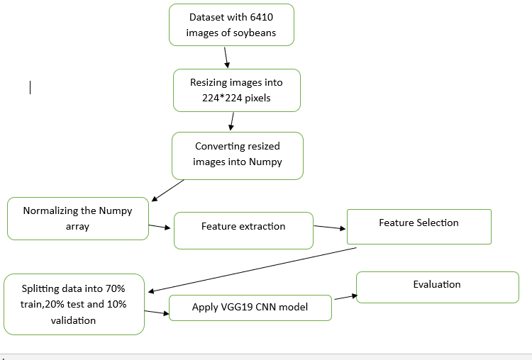
BLOCK DIAGRAM OR FLOW DIAGRAM

Slide 13
METHODOLOGY
Data Set Collection:
Utilized an open-source dataset comprising 6,410 soybean leaf images classified into three categories: healthy, infested with caterpillars, and infested with Diabrotica Speciosa.
Data Preprocessing:
Image Loading and Resizing: Loaded the dataset and defined the input image dimensions (226x226 pixels).The images were then resized to a uniform dimensions of 224x224 pixels to meet the input size requirement of the vGG19 model. After resizing , the images were converted into NumPy arrays for efficient processing in machine learning framework.
Image Normalization:The images were Normalized to a pixel range of 0 to 1,Which facilitated faster training and allowed the model the model to focus on key features without being influenced by extreme pixel values
Feature Extraction and Selection:Features were extracted from the images using various processing techniques.

Slide 14
and dimensionality reduction was applied to select the most relevant features, improving classification efficiency.
Data Splitting: Divided the dataset into training (70%), validation (10%), and testing (20%) sets for model training, evaluation, and final performance assessment.
Model Building:
Model selection: Choose an appropriate model for classification , such as VGG19 Convolutional Neural Network(CNN) for image-based tasks.
Model Architecture: Define the layers of the CNN, which typically includes:
Convolutional layers for feature extraction.
Pooling layers for dimentionality reduction.
Fully connected layers for classification.

Slide 15
Model training: Train the model using the preprocessed dataset with selected features. This step involves optimizing the weights using a suitable loss function, such as cross-entropy loss, and an optimizer like adam.
Model Evaluation:
Accuracy: Overall classification accuracy is 99.5%.
Precision: Accuracy of positive predictions is 99.0%.
F1-Score: Harmonic mean of precision and recall is 99.0%.

Slide 16
IMPLEMENTATION
Software Specifications:
Programming Languages: Python.
Libraries Used:TensorFlow , Keras ,Scikit- Image ,OpenCV ,MatplotLib ,Seaborn.
Data Storage: Soybeanleaf Dataset in image format.
Development Environment: Google Colab for model
Hardware Specifications:
System :NVIDIA GPU-enabled machine for accelerated training.
Processor :Intel Core i5 or euivalent.
RAM :Minimum 16GB for handling dataset and model complexity.
Storage :SSD for faster data access and storage.

Slide 17
Read the Dataset:
import os
soybean_leaf_dataset_path = os.path.join('/content/drive/My Drive', 'soybean.leaf.dataset')
files = os.listdir(soybean_leaf_dataset_path)
print(files)
Printing number of Classes in Dataset:
classes = len([name for name in os.listdir(soybean_leaf_dataset_path) if os.path.isdir(os.path.join(soybean_leaf_dataset_path, name))])
print(f"Number of classes: {classes}")
Resize the images:
import os
import matplotlib.pyplot as plt
from PIL import Image

Slide 18
soybean_leaf_dataset_path = os.path.join('/content/drive/My Drive', 'soybean.leaf.dataset1')
files = os.listdir(soybean_leaf_dataset_path)
print(files)
classes = len([name for name in os.listdir(soybean_leaf_dataset_path) if os.path.isdir(os.path.join(soybean_leaf_dataset_path, name))])
print(f"Number of classes: {classes}")
classes = [name for name in os.listdir(soybean_leaf_dataset_path) if os.path.isdir(os.path.join(soybean_leaf_dataset_path, name))]
print(f"Classes present in the dataset: {classes}")
def display_one_image_per_class(classes, soybean_leaf_dataset_path):
for class_name in classes:

Slide 19
image_path = os.path.join(soybean_leaf_dataset_path, class_name, os.listdir(os.path.join(soybean_leaf_dataset_path, class_name))[0])
img = Image.open(image_path)
img = img.resize((224, 224)) # Resize the image to 224x224 pixels
print("Image size: ", img.size) # Print the size of the image
plt.imshow(img)
plt.title(class_name)
plt.show()
display_one_image_per_class(classes, soybean_leaf_dataset_path)
converting into Numpy array:
import numpy as np
from PIL import Image
def load_images_to_numpy_array(folder_path):

Slide 20
images = []
for filename in os.listdir(folder_path):
image_path = os.path.join(folder_path, filename)
image = Image.open(image_path)
image = image.resize((224, 224))
image_array = np.array(image)
images.append(image_array)
return np.array(images)
class_arrays = {}
for class_name in classes:
class_folder_path = os.path.join(soybean_leaf_dataset_path, class_name)
class_arrays[class_name] = load_images_to_numpy_array(class_folder_path)
for class_name, images_array in class_arrays.items():
print(f"Class: {class_name}, Shape: {images_array.shape}")

Slide 21
Normalize the data:
for class_name, images_array in class_arrays.items():
class_arrays[class_name] = (images_array - np.min(images_array)) / (np.max(images_array) - np.min(images_array))
for class_name, images_array in class_arrays.items():
print(f"Class: {class_name}, Shape: {images_array.shape}")
Extracting Features:
import tensorflow as tf
from tensorflow.keras.applications import VGG16
from tensorflow.keras.models import Model
base_model = VGG16(weights='imagenet', include_top=False, input_shape=(224, 224, 3))
feature_extractor = Model(inputs=base_model.input, outputs=base_model.get_layer('block5_pool').output)

Slide 22
class_features = {}
for class_name, images_array in class_arrays.items():
class_features[class_name] = feature_extractor.predict(images_array)
for class_name, features in class_features.items():
print(f"Class: {class_name}, Feature Shape: {features.shape}")
Select Features:
flattened_features = {}
for class_name, features in class_features.items():
flattened_features[class_name] = features.reshape(features.shape[0], -1)
for class_name, features in flattened_features.items():
print(f"Class: {class_name}, Flattened Feature Shape: {features.shape}")

Slide 23
Splitting Dataset:
from sklearn.model_selection import train_test_split
X = np.concatenate(list(flattened_features.values()), axis=0)
y = np.concatenate([np.full(features.shape[0], i)
for i, features in enumerate(flattened_features.values())])
X_train, X_temp, y_train, y_temp = train_test_split(X, y, test_size=0.3, random_state=42)
X_val, X_test, y_val, y_test = train_test_split(X_temp, y_temp, test_size=0.5, random_state=42)
print("Train set shapes - X: {}, y: {}".format(X_train.shape, y_train.shape))
print("Validation set shapes - X: {}, y: {}".format(X_val.shape, y_val.shape))
print("Test set shapes - X: {}, y: {}".format(X_test.shape, y_test.shape))

Slide 24
Apply model:
from tensorflow.keras.applications import VGG19
base_model = VGG19(weights='imagenet', include_top=False, input_shape=(224, 224, 3))
feature_extractor = Model(inputs=base_model.input, outputs=base_model.get_layer('block5_pool').output)
class_features = {}
for class_name, images_array in class_arrays.items():
class_features[class_name] = feature_extractor.predict(images_array)
for class_name, features in class_features.items():
print(f"Class: {class_name}, Feature Shape: {features.shape}")

Slide 25
Printing training vs testing accuracy:
train_accuracies = [0.9, 0.92, 0.93, 0.99]
accuraciestest_accuracies = [0.85, 0.87, 0.88, 0.99] epochs = range(1, len(train_accuracies) + 1)
plt.plot(epochs, train_accuracies, 'b', label='Training Accuracy')
plt.plot(epochs, test_accuracies, 'r', label='Testing Accuracy')
plt.title('Training and Testing Accuracy')
plt.xlabel('Epochs')
plt.ylabel('Accuracy')
plt.legend()
plt.show()

Slide 26
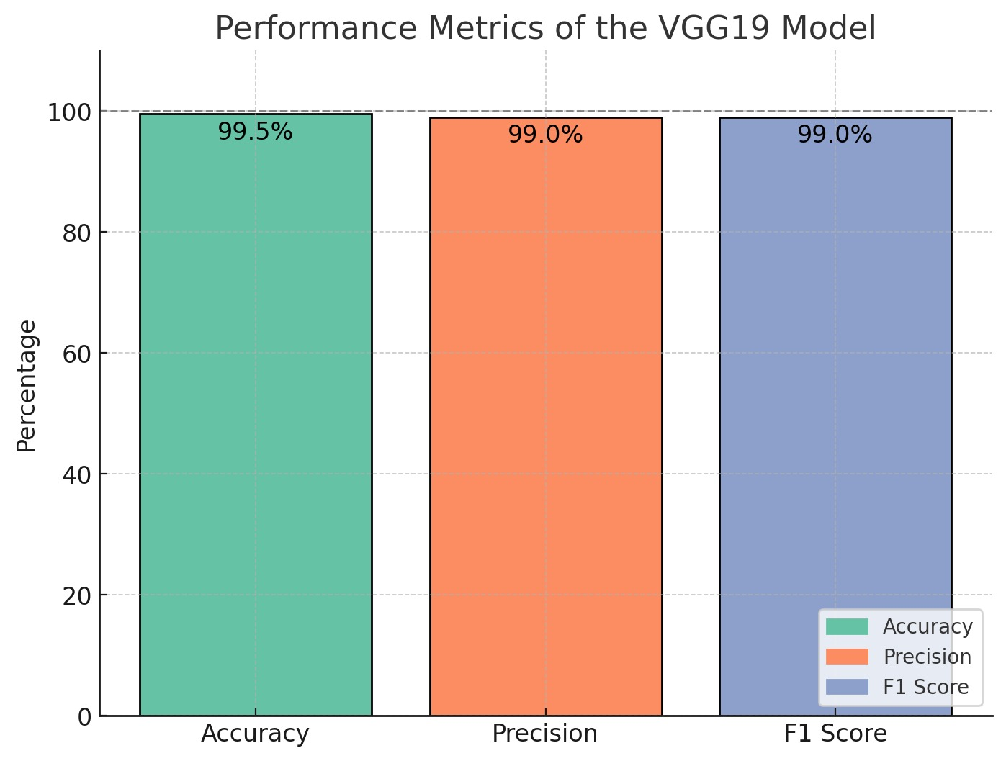
RESULTS & ANALYSIS

Slide 27
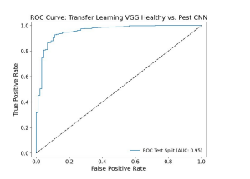
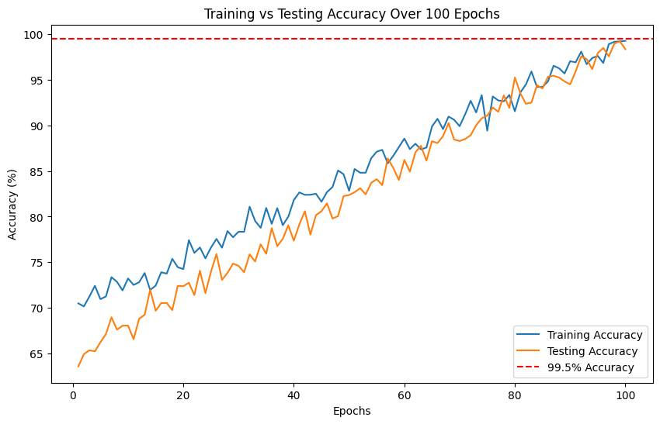

Slide 28
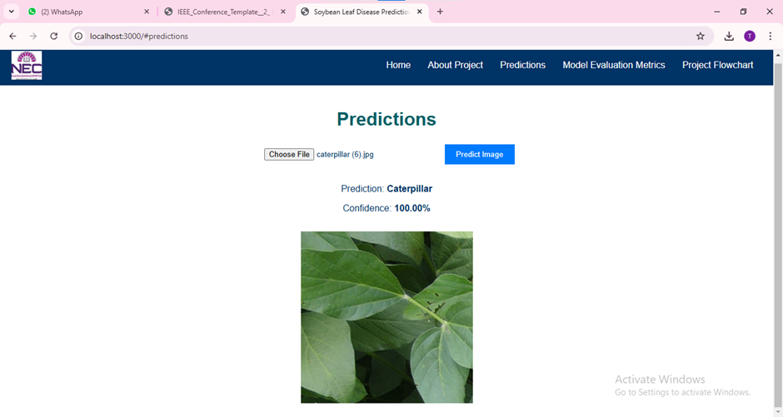
Test case1: Caterpillar

Slide 29
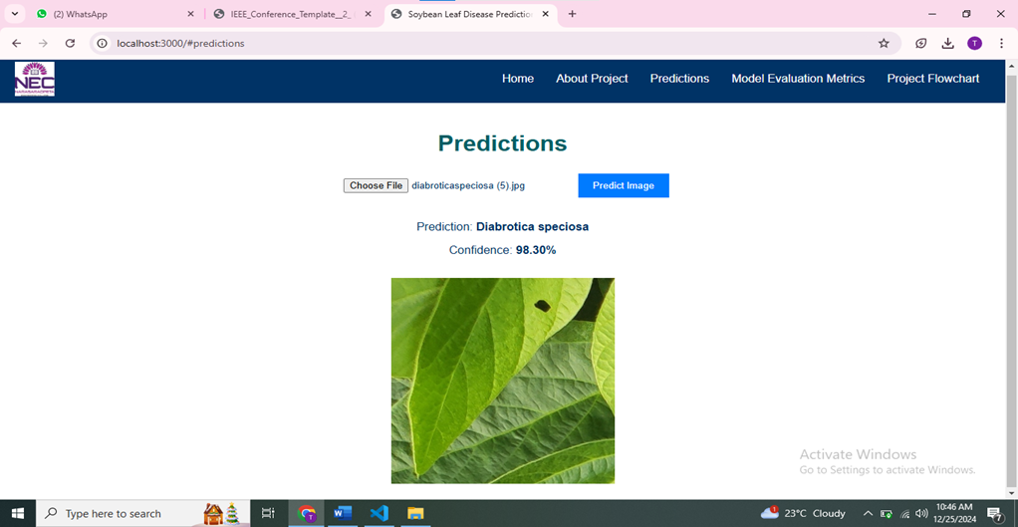
Test case2: Diabrotic speciosa

Slide 30

Home screen:

Slide 31
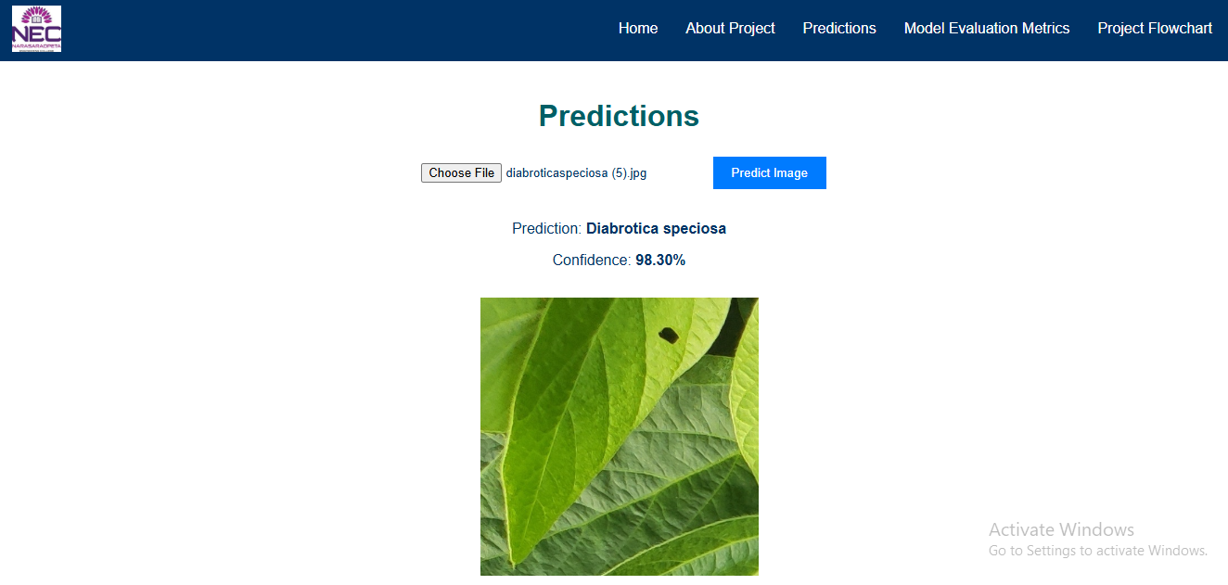
Output Screen

Slide 32
CONCLUSION
This study successfully demonstrates the application of deep learning, specifically the VGG19 Convolutional Neural Network, in detecting pest infestations in soybean leaves. With an accuracy of 99.5%
Achieving reliable results with a modest dataset. This contributes significantly to integrated pest management (IPM) by providing a scalable and accurate tool for early pest detection, potentially reducing economic losses and environmental harm.
The results show that VGG19 is a very suitable convolutional network for this task and could improve and support IPM
The accuracy and reliability of our model suggest that it has the potential to be a valuable tool for the soybean industry, enabling more targeted use of pesticides or alternative techniques and helping to reduce the cost and environmental impact of treating infested soybean leaves.

Slide 33
FUTURE SCOPE
Enhanced Model Performance: Future studies can explore advanced architectures such as Xception, GoogLeNet, and AlexNet to further improve detection accuracy and model robustness.
This study demonstrates the potential of deep learning, specifically VGG19, to revolutionize integrated pest management through accurate, scalable, and early detection of soybean leaf infestations.
Limited Pest Categories:
We focuses only on two pest types (Diabrotica speciosa and caterpillars).
Scalability and Real-Time Application:
While the model achieves high accuracy, its deployment in real-time systems might face challenges related to computational efficiency and hardware limitations.

Slide 34
REFERENCES
R. N. Strange and P. R. Scott, ”Plant disease: A threat to global food security,” *Annual Review of Phytopathology*, vol. 43, pp. 83–116, 2005.
B. Zolghadr -Asli, N. McIntyre, S. Djordjevic, R. Farmani, and L. Pagliero , ”The sustainability of desalination as a remedy to the water crisis in the agriculture sector: An analysis from the climate-water energy -food nexus perspective,” *Agricultural Water Management*, vol. 286, Art. no. 108407, 2023
J. P. Deguine , P. Ferron, and D. P. Russell, ”Sustainable pest management for cotton production,” in *Sustainable Agriculture*, E. Lichtfouse , M. Navarrete, P. Debaeke , V. Souchere, and C. Alberola , Eds. Dordrecht, ` Netherlands: Springer, 2009, pp. 411–442.
N. Farah, N. Drack, H. Dawel, and R. Buettner, ”A Deep LearningBased Approach for the Detection of Infested Soybean Leaves,” *IEEE Access*, vol. 11, pp. 99670-99679, 2023, doi: 10.1109/ACCESS.2023.3313978.
J. P. Nyakuri, C. Nkundineza, O. Gatera, and K. Nkurikiyeyezu, ”State of-the-Art Deep Learning Algorithms for Internet of Things-Based Detection of Crop Pests and Diseases: A Comprehensive Review,” *IEEE Access*, vol. 12, pp. 169824-169849, 2024, doi: 10.1109/ACCESS.2024.3455244.

Slide 35
N. Kaler, V. Bhatia, and A. K. Mishra, ”Deep Learning-Based Robust Analysis of Laser Bio-Speckle Data for Detection of Fungal-Infected Soybean Seeds,” *IEEE Access*, vol. 11, pp. 89331-89348, 2023, doi: 10.1109/ACCESS.2023.3305273.
H. Yoo, ”Deep convolution neural networks in computer vision: a review,” *IEIE Trans. Smart Process. Comput.*, vol. 4, no. 1, pp. 35–43, Feb. 2015, doi: 10.5573/IEIESPC.2015.4.1.035.
M. M. Hammad, ”Deep learning activation functions: Fixedshape, parametric, adaptive, stochastic, miscellaneous, nonstandard, ensemble,” *arXiv*, 14 Jul. 2024. [Online]. Available: https://doi.org/10.48550/arXiv.2407.11090.
V. Balafas, E. Karantoumanis, M. Louta, and N. Ploskas, ”Machine learning and deep learning for plant disease classification and detection,” *IEEE Access*, vol. 11, pp. 114352-114377, 2023, doi: 10.1109/ACCESS.2023.3324722.
E. Moupojou et al., ”FieldPlant: A dataset of field plant images for plant disease detection and classification with deep learning,” *IEEE Access*, vol. 11, pp. 35398-35410, 2023, doi: 10.1109/ACCESS.2023.3263042

Slide 36
QUESTIONS and ANSWERS
Any Questions

Slide 37
ACKNOWLEGEMENTS
Thankyou for the opportunity to present our research on the “Deep Learning Solutions for Soybean Leaf Infestation Detection :VGG19 Approach”. We appreciate your interest in our work and are eager to contribute to advancements in soybean leaf infestation detection.
Dasari Triveni
dasaritriveni66@gmail.com
Borugadda Supriya
borugaddasupriya9@gmail.com
Polimera Bhagya Lakshmi
pbhagya2003@gmail.com

Slide 38
Thank You

